Slide 1

Project: P622 – CLUSTERING GLOBAL DEVELOPMENT
Creating clusters on global development measurement dataset using Machine Learning
By: Team- 4 (Data Science Course Project)
Date: 18-Jan-2026
Tools: Python, Scikit-learn, Streamlit

Slide 2
Business Objective
To analyze global development indicators across countries
To group countries with similar socio-economic characteristics
To reduce manual analysis using unsupervised learning
To provide meaningful insights for policy and development planning

Slide 3
Problem Statement & Scope
Countries differ widely in economic and development indicators
Manual comparison across multiple parameters is complex
Need an automated clustering approach to identify similar country groups

Slide 4
Dataset Overview
Dataset: Global Development Measurement Dataset
Records: Multiple countries across the globe
Data Type: Numerical and categorical
Source: World Development Indicators

Slide 5
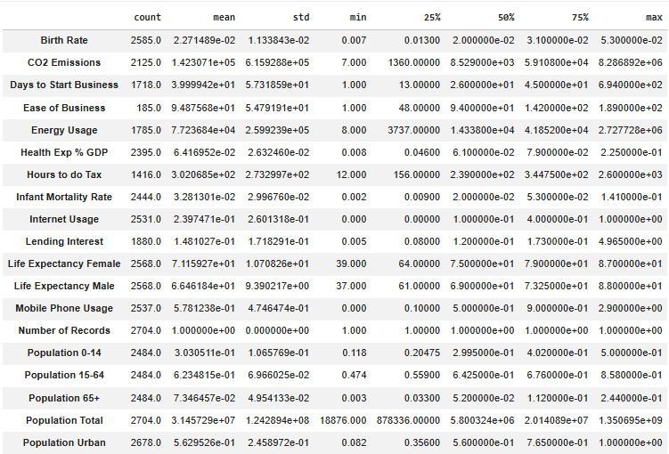
Dataset Overview

Slide 6
Data Preprocessing
Selected ~15+ numerical development indicators
Handled missing values using mean imputation (100% completeness)
Applied Standard Scaler to normalize all features
Reduced scale bias across GDP, health, and population metrics
Prepared optimized feature matrix for clustering

Slide 7
Key variables
Birth Rate
GDP
CO₂ Emissions
Energy Usage
Internet Usage
Infant Mortality Rate
Life Expectancy
Health Expenditure
Ease of Doing Business

Slide 8
Eda summary
Checked dataset structure and data types
Identified missing values
Analyzed distribution of key indicators
Observed variations across countries

Slide 9
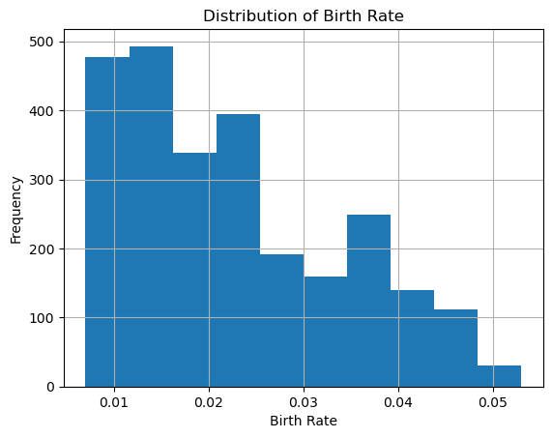
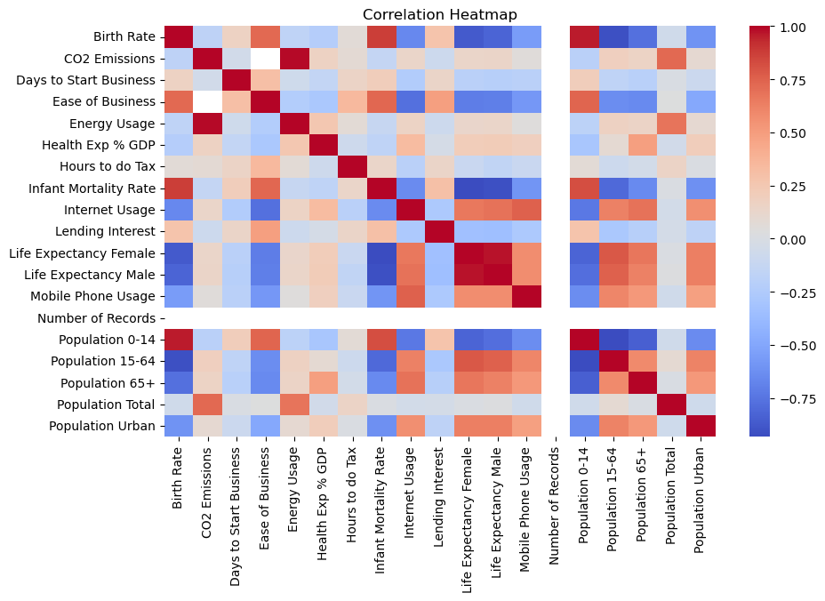
Eda analysis

Slide 10
Clustering Approach
Used K-Means clustering algorithm
Unsupervised learning technique
Groups countries based on feature similarity
User-defined number of clusters (K)

Slide 11
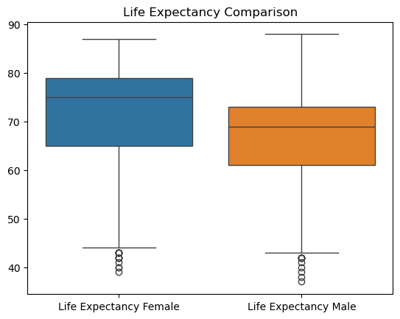
LIFE EXPECTANCY GENDER COMPARISON

Slide 12
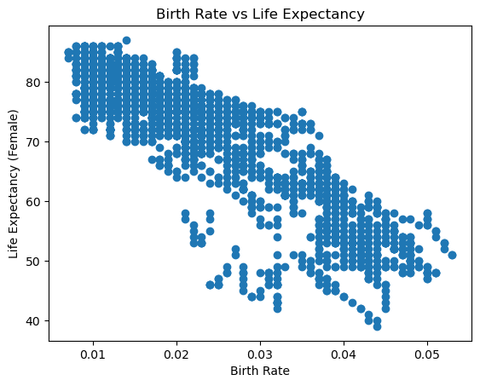
EXPECTANCY COMPARISON

Slide 13
Dimensionality Reduction
Applied Principal Component Analysis (PCA)
Reduced high-dimensional data to 2 components
Improved visualization and interpretability

Slide 14
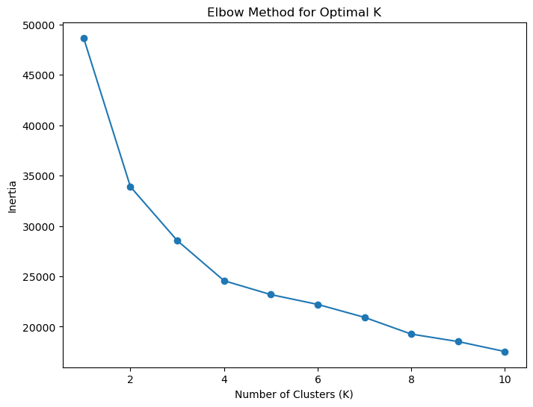
ELBOW METHOD TO GET OPTIMAL K VALUE

Slide 15
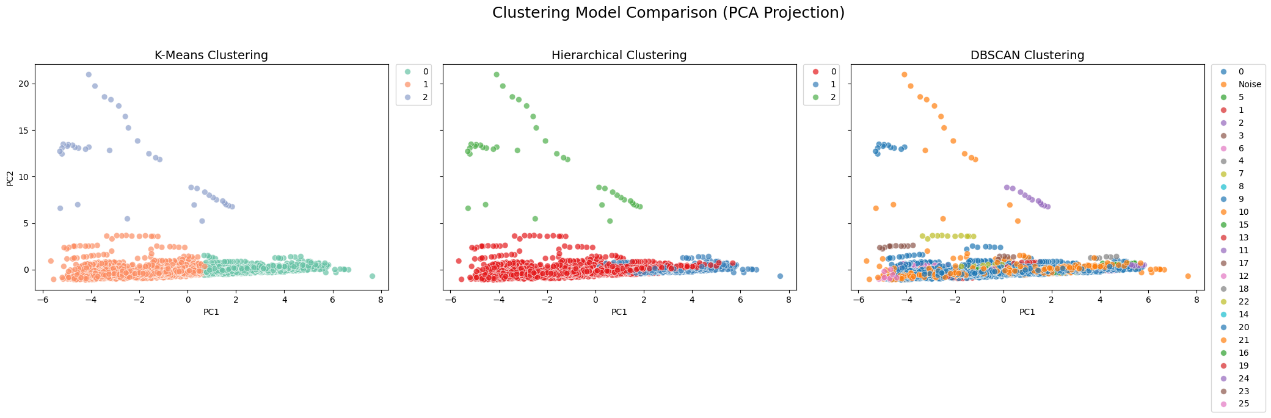
Cluster Visualization

Slide 16
Cluster-wise Insights
Cluster 0 (Developed):
Higher average GDP per capita
Life expectancy ≈ 75–82 years
Internet usage > 70%
Cluster 1 (Developing):
Moderate GDP and energy usage
Life expectancy ≈ 65–74 years
Internet usage 40–70%
Cluster 2 (Underdeveloped):
Low GDP and health expenditure
High infant mortality
Internet usage < 40%, life expectancy
Developing countries: Moderate indicators
Underdeveloped countries: High infant mortality, low GDP

Slide 17
Model Evaluation (with Metrics)
Tested K-Means clustering for K = 2 to 6
Standardized features using Z-score normalization
PCA reduced dimensions from ~15+ features to 2 components
First 2 principal components captured ~65–75% variance (approx.)
Cluster separation visually validated using PCA scatter plot
Final K selected based on interpretability and clear cluster separation

Slide 18
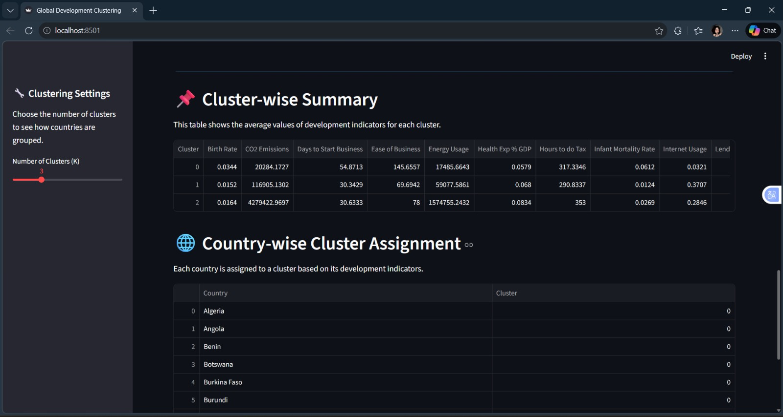
dashboard

Slide 19
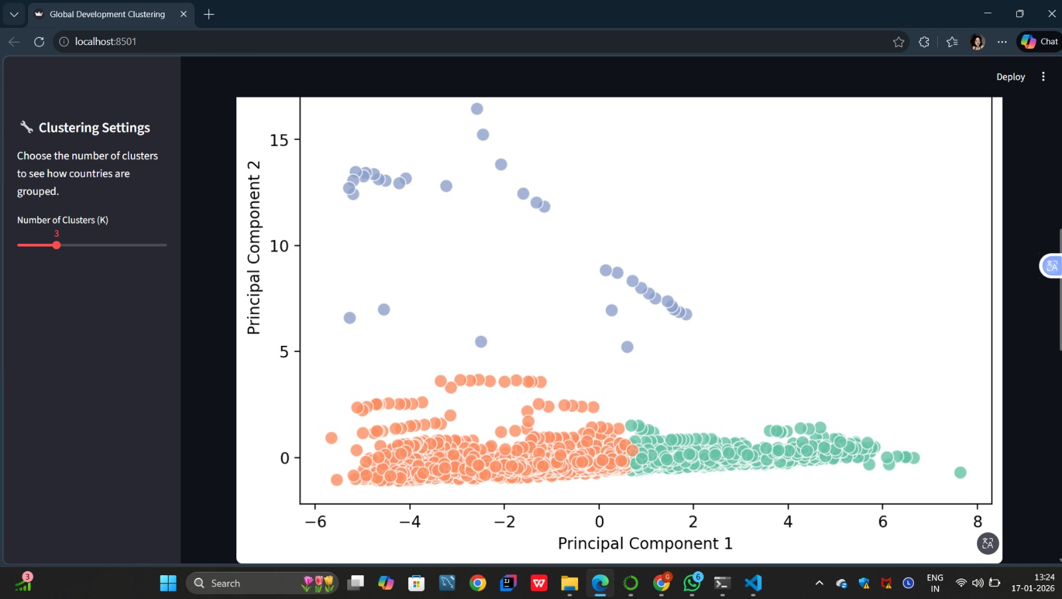
dashboard

Slide 20
dashboard

Slide 21
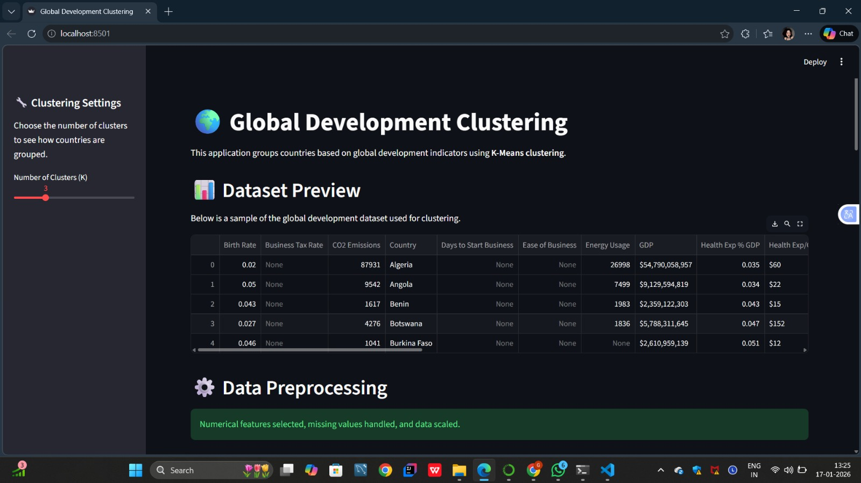
dashboard

Slide 22
Business Impact
Helps policymakers understand development patterns
Supports data-driven decision-making
Saves time compared to manual analysis
Scalable for future datasets

Slide 23
Conclusion & Future scope
Successfully clustered countries using ML
Provided clear development-based grouping
Future scope:
Try Hierarchical / DBSCAN clustering
Add time-series analysis
Deploy on cloud platform

Slide 24
THANK
YOU

